Slide 1

IT-648: IT Risk Management
Week 9
Sonja Streuber

Slide 2
Agenda
# | Topic | Reading | Due 11:59 pm CST on Blackboard
9 | Hardware and Software Controls (1): Password management, Access control, Firewalls | Agrawal 9 Other materials on Blackboard | W: Post F: Responses S: LAB_9

Slide 3
Chapter 9 (week 9)
Hardware and Software Controls

Slide 4
Overview
By the end of this week, you will be able to:
Define Password Management
Describe and build Access control lists (ACLs)
Analyze Firewalls and their capabilities
Use Intrusion Detection/Prevention Systems
Strategize how to patch operating systems and applications
Deploy End Point Protection
Discuss and apply Information security control best practices

Slide 5
Passwords

Slide 6
Passwords
Definitions
Identification
Presentation of a user identity for the system
Typically by a username
Authentication
Establishing confidence in the validity of a claimed identity
Typically using a password
Secret series of characters known only to owner
Design goals of passwords
Simple enough for average users
Secure enough for most applications

Slide 7
Password Types: Personal Identification Number (PIN)
Short (4-6 digits), numerical password
Useful when
Small keypads are necessary, e.g. ATM machines, or
Regular passwords could potentially create human safety problems
E.g. airport fire suppression systems
Relatively insecure
Short and can be easily guessed
Only provide limited security
Generally assumes existence of other security mechanisms
E.g. daily withdrawal limits and security cameras in ATMs
Physical security at airports

Slide 8
Password Types: Passphrase
Sequence of words that serves as a password
E.g. - Wow!!!thisis#1clasatschooL
Motivation
Human brain can only retain up to about 7 chunks of information in short term memory
But each chunk can be fairly large
So, passphrases can be longer than passwords
But easier to remember than an arbitrary sequence of characters
However, long passphrase not necessarily safer
Simple passphrases such as “thisisthe#1classatschool” can be predictable and easily guessed by attackers
Compared to passwords such as “TiT#`CaS.”

Slide 9
Password management
So far, you have been a user of passwords
In profession, you are on the other side
Making it all work
In particular
Information security of passwords in your custody
Accomplished through password management
Process of defining, implementing, and maintaining password policies throughout an enterprise
Reduce likelihood that systems using passwords will be compromised
NIST Special publication 800-118
Guide to enterprise password management

Slide 10
Password management: InfoSec
CIA triad re-introduced
Organizations need to protect the confidentiality, integrity, and availability of passwords
Asset management terminology
Passwords are restricted and essential information assets
Loss of confidentiality or integrity can give intruders improper access to information
Hence, passwords are restricted assets
Non-availability of a password can make underlying protected resource unavailable
Hence, passwords are essential

Slide 11
Password management: Standards
National Institute for Standards and Technology (NIST)
Guidelines for minimum recommendations regarding password management
Basis for discussion here
Specific organizations may have more stringent password management requirements
E.g. Banks, hospitals
May impose additional requirements
Including
Requiring mechanisms other than passwords for authentication

Slide 12
Password management: Threats
For optimal (minimal) investment
Begin with recognition of threats which can compromise passwords
Take actions to minimize likelihood of these compromises
NIST recognizes 4 threats to passwords
Password capturing
Password guessing and cracking
Password replacing
Using compromised passwords

Slide 13
Password threats
Password capturing
Ability of an attacker to acquire a password from storage, transmission, or user knowledge and behavior
Improper storage
Unencrypted transmission
Password guessing
An intruder makes repeated attempts to authenticate using possible passwords such as default passwords and dictionary words
Password cracking
Process of generating a character string that matches any existing password string on the targeted system
Requires unrestricted access to encrypted versions of saved passwords

Slide 14
Password threats – contd.
Password replacing
Substitution of the user’s existing password with a password known to the attacker
Generally happens using various social engineering techniques
Exploiting weaknesses in the system’s password reset policies
Using compromised passwords
Passwords on the system known to unauthorized users
May be exploited to launch other social engineering attacks, change file permissions on sensitive files
If the compromised password is of a privileged user
E.g. an IT administrator
Attacker may even be able to modify applications and systems for later exploitation
E.g. create a privileged account for himself (most attackers are indeed men!)

Slide 15
Password management: Recommendations
Implemented as a password policy
Set of rules for using passwords
For users
What kinds of passwords are allowed
E.g. length and complexity rules for passwords
For administrators
How passwords may be stored, transmitted issued to new users and reset as necessary
E.g. account for any industry-specific regulations

Slide 16
Password management – contd.
Dealing with password guessing and cracking
Pay attention to password storage
Access to files and databases used to store passwords should be tightly restricted
Save password hashes, not passwords
Encrypt all password exchange
Strictly verify identity of all users who attempt to recover forgotten passwords or reset passwords
Educate all users of password stealing attempts through phishing attacks, shoulder surfing, and other methods
Passwords must be made sufficiently complex
Accounts must be locked after many successive failed login attempts
Minimizes opportunities for hackers to guess a password

Slide 17
Password management – contd.
Password expiration
Duration for which password may be used without change
Reduces likelihood that compromised password can be used productively
Often, passwords collection and password usage are separate operations
Creates delay before compromised password is used
Password compromise may not be very damaging
If password is changed before the attacker attempts to use it
Problems
Particularly in absence of password synchronization or SSO
Users forget passwords
Costly IT support to recover forgotten passwords
Hence
Use judiciously
Longest possible durations

Slide 18
Password limitations and alternatives
Users often forget passwords
Help desks to respond to user requests
Expensive
Password reset mechanisms
Challenge questions may not be strong enough
Relatively simple social engineering attacks such as phishing can exploit reset mechanisms
Hence, considerable interest in developing alternatives
Not trivial
Users know how to use passwords
Limited data available on actual losses suffered by organizations due to password theft
Why fix what is not broken
Proposals for alternatives
Passfaces
User pre-selects a set of human faces and the user selects a face from this set among those presented during a login attempt
Draw-a-secret
Users draw a continuous line across a grid of squares

Slide 19
Access Control

Slide 20
Access control
Limiting access to information system resources only to authorized users, programs, processes, or other systems
E.g. Locks
Access control models
Descriptions of the availability of resources in a system
Representation of access control in computer security
Properties of access control models
Represent protection needs of any resource at varying levels of granularity
Without unreasonable computational burden on operating system
Popular access control models
Access control lists (ACLs)
Role-based access control (RBAC)

Slide 21
Access control lists (ACLs)
List of permissions attached to specified objects
Use simple syntax to specify
Subjects
Objects
Allowed operations
E.g.
Network connection
ACL: (131.247.93.68, ANY, block)
Subject: Host 131.247.93.68
Object: ANY resource on the network
Operation: Block from passing through the network connection
Operating system checks all incoming resource requests
Any ACL entry may prohibit access to the resource

Slide 22
Access control lists (ACLs) – contd.
Common use
Files
Specify rights for users or groups to files and executables
E.g. chmod command
System Administration chapter
Network connections
Specify port numbers and network addresses that may be accessed
Common way to implement firewalls
Default ACLs
Present in most modern operating systems
Provide reasonable levels of security for the average user
Properties
Some of the simplest controls to implement
Basis for many other security controls
E.g. prevent over-writing of passwords

Slide 23
Access matrix
Simple representation of ACLs
Subjects attempt operations on objects
Operations permitted if allowed by ACL
Cells show permissions for subject on object
ACL for user on corresponding object
E.g. File 1
Subject John is owner
Has read and write permissions on file
Can assign any permission to any user on file
Subject Bob
Given read permission
Subject Alice
Given execute permission
 |  | Objects
 |  | Host 1 | File 1 | File 2
Subjects | John | Block | Own Read Write | Read
 | Bob | Block | Read | Read
 | Alice | Allow | Execute | Own Read Write Execute

Slide 24
ACL limitations
Limited scalability
To modify permissions for a specific user
Permissions for that user must be modified individually on all objects to which the user has access
Not possible to assign permissions based on user responsibilities
When user changes roles
Role-appropriate permissions for the user must be modified individually on all applicable objects

Slide 25
Role based access control (RBAC)
Assign permissions to user roles rather than to individual users
Roles are created for job functions
Users are assigned roles based on responsibilities
Access permissions defined for roles
Separation between users and access controls
As users evolve within the organization
Roles can be assigned
Access permissions are automatically updated
RBAC reduces cost and administrative effort, compared to ACLs
But tool support evolving

Slide 26
Firewalls

Slide 27
Firewalls
Hardware or software that prevent the dangers originating on one network from spreading to another network
Allow one network to connect to another network while maintaining some amount of protection
E.g. door to a home or office
Allow residents to get out of the house
Block rain and sleet from entering the home
Maintain some degree of confidentiality
Serve multiple purposes
Restricting entry and exit from the network to carefully specified locations
Limiting incoming Internet traffic to specific application running on specific devices
Blocking outgoing traffic from hosts suspected to have been compromised

Slide 28
Firewalls – contd.
Constraints
Not generally intended to defend against specialized attacks
E.g. Doors of a retail store are not designed to detect shoppers with explosives, or shoplifters
Where necessary (e.g. at airports)
Left to more specialized controls, e.g.
Human inspectors
Anti-theft technologies
Benefits
Very effective and relatively inexpensive first line of defense
Defend against large number of common nuisances

Slide 29
Firewall arrangement
Figure shows typical arrangement
Intercept all traffic between the Internet and the organization’s network
Implement organization’s traffic rules

Slide 30
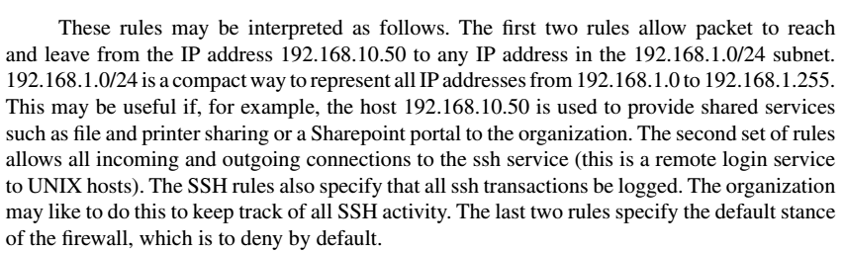
Firewall rules
Specified using ACL syntax, e.g.
pass in quick from 192.168.1.0/24 to 192.168.10.50
pass out quick from 192.168.10.50 to 192.168.1.0/24
pass in log quick from any to any port = 22
pass out log quick from any port = 22 to any
block in all
block out all

Slide 31
Firewall limitations
Defenseless against insiders and unregulated traffic
Protect against attacks originating outside the network
Traffic inside the organization does not cross firewall
Compromised computer can steal data from other computers
Defenseless against user practices
Flash storage devices
Defenseless against encrypted traffic
Cannot be inspected
E.g. SSL traffic
Configuration
Poorly configured firewall
Only provides illusion of security

Slide 32
Firewall types
Packet filtering firewalls
Examine protocol header fields to determine entry, e.g.
Source and destination IP addresses
Destination port address
TCP flags
Example usage
Block incoming packets from ISP with history of sending spam
Host or ISP identified by the source IP address field
Deep packet inspection firewalls
Examine packet data, in addition to protocol headers
Compare against database of known malicious payloads
Identify payloads that attempt to launch buffer overflow or other attacks

Slide 33
Typical firewall organization
Typical deployment involves
Perimeter firewall
Lies between the external network and the organization
Allows hosts outside the organization to access public-facing services
E.g. web, email and DNS.
De-militarized zone
Network between external network and organization’s internal network
Hosts external services such as http, smtp and DNS
Interior firewall
Limits access to organization’s internal network
Specific applications for requests originating from specific hosts
E.g. Student learning system and records database
Militarized zone
Location of all the organization’s information assets

Slide 34
Typical firewall organization

Slide 35
Basic firewall recommendations
Allow users to access to the following services on the Internet
Web (port 80, 443) to specified hosts running web servers
Email (ports 25, 465, 585, 993, 995) to specified hosts running email
DNS (port 53) to specified hosts running the DNS service
Remote desktop connections (port 3389)
SSH (port 22) to specific UNIX hosts
General rules of thumb
Allow “secure” services
Encrypt transactions
In popular use, hence regularly updated
SSH (for UNIX connections) and Remote Desktop (for Windows clients)
Allow access to “safe” services on designated hosts
E.g. email and the web
Block legacy, unmaintained services
Telnet and FTP

Slide 36
Centos 7: Firewall Zones
drop:
block:
public:
external:
internal:
dmz:
work:
home:
trusted:
The lowest level of trust. All incoming connections are dropped without reply and only outgoing connections are possible.
Similar to the above, but instead of simply dropping connections, incoming requests are rejected with an icmp-host-prohibited or icmp6-adm-prohibited message.
Represents public, untrusted networks. You don't trust other computers but may allow selected incoming connections on a case-by-case basis.
External networks in the event that you are using the firewall as your gateway. It is configured for NAT masquerading so that your internal network remains private but reachable.
The other side of the external zone, used for the internal portion of a gateway. The computers are fairly trustworthy and some additional services are available.
Used for computers located in a DMZ (isolated computers that will not have access to the rest of your network). Only certain incoming connections are allowed.
Used for work machines. Trust most of the computers in the network. A few more services might be allowed.
A home environment. It generally implies that you trust most of the other computers and that a few more services will be accepted.
Trust all of the machines in the network. The most open of the available options and should be used sparingly.

Slide 37
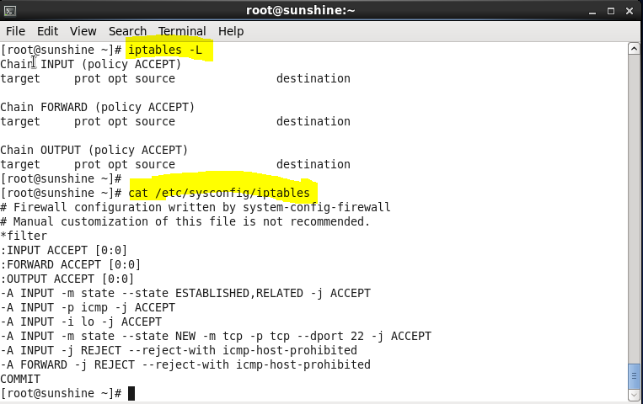
Centos 6 or 7: Iptables
Review firewall rules
Review existing firewall configuration

Slide 38
Centos 6 or 7: Iptables
/etc/sysconfig/iptables
.# This firewall is an example of a Linux web, ftp, pop3 & smtp server .# It also limits ssh access to a block of IP - you need to customize the IPs to match your allowed IPs for ssh access *filter :INPUT ACCEPT [0:0] :FORWARD ACCEPT [0:0] :OUTPUT ACCEPT [131962:7397220] :inputf - [0:0] -A INPUT -j inputf -A FORWARD -j inputf -A inputf -i lo -j ACCEPT -A inputf -m state --state RELATED,ESTABLISHED -j ACCEPT -A inputf -p tcp -m state --state NEW -m tcp --dport 80 -j ACCEPT -A inputf -p tcp -m state --state NEW -m tcp --dport 443 -j ACCEPT -A inputf -p tcp -m state --state NEW -m tcp --dport 21 -j ACCEPT -A inputf -p tcp -m state --state NEW -m tcp --dport 25 -j ACCEPT -A inputf -p tcp -m state --state NEW -m tcp --dport 110 -j ACCEPT -A inputf -s 192.168.1.0/24 -p tcp -m tcp --dport 22 -j ACCEPT -A inputf -p ipv6-crypt -j ACCEPT -A inputf -p ipv6-auth -j ACCEPT -A inputf -j REJECT --reject-with icmp-host-prohibited COMMIT
Research the port numbers—what services is this file managing?

Slide 39
Chapter Review Questions (1)
What is a password? What is it used for?
Briefly describe some alternate forms of passwords.
What is password management? Why is it necessary?
What are the important threats to passwords?
What are the important recommendations for password management?
What are some advantages and limitations of passwords?
What are firewalls? What are their common uses?
Write an example firewall rule using the syntax shown in the chapter. Describe what the rule does.
Write a firewall rule that blocks all incoming web requests (port 80) from the 192.168.0.0/16 network.
What are some limitations of firewalls?
What are deep packet inspection firewalls? What additional capabilities do they offer, compared to packet-filtering firewalls?
What are the differences between the perimeter network and the interior network, from the perspective of information security?
Draw a diagram of a typical enterprise firewall organization, showing the perimeter firewall, interior firewall, demilitarized zone, and internal network.
What are the recommendations for a basic firewall configuration?

Slide 40
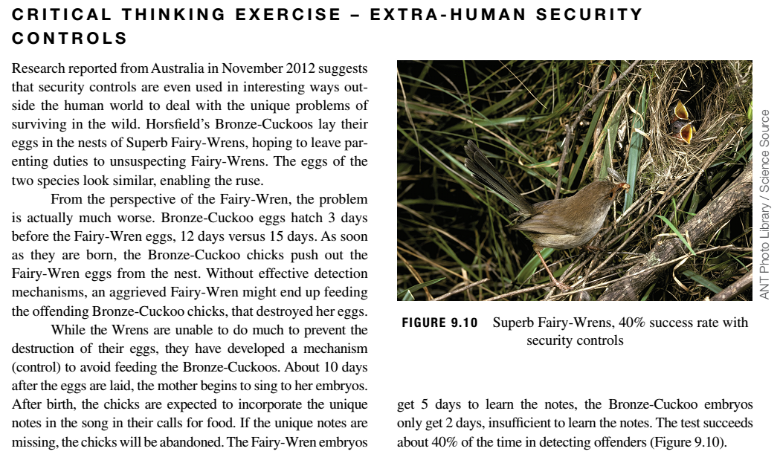
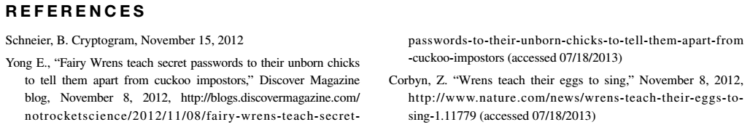
Critical Thinking Exercise

Slide 41
Critical Thinking Exercise Questions
Of the controls discussed in this chapter, which control most closely resembles the control used by Fairy-Wren mothers to detect imposters?
The control used by Fairy-Wren mothers seems rather complex. Some simpler controls suggest themselves. Could you name a few?

Slide 42
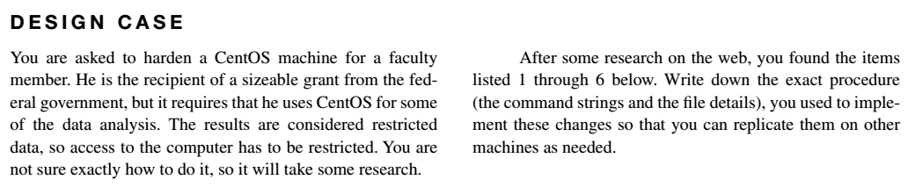
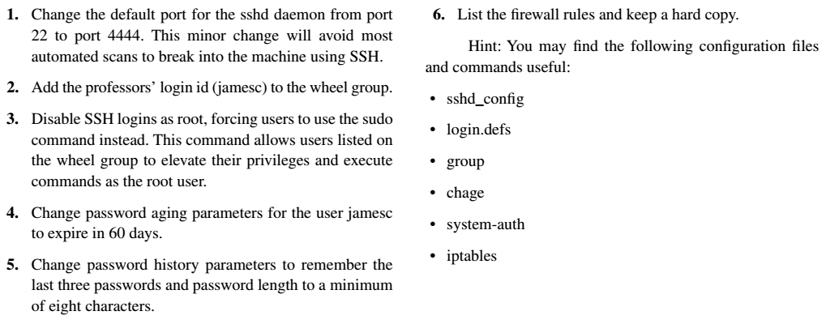
Hands-On: Design Case

Slide 43
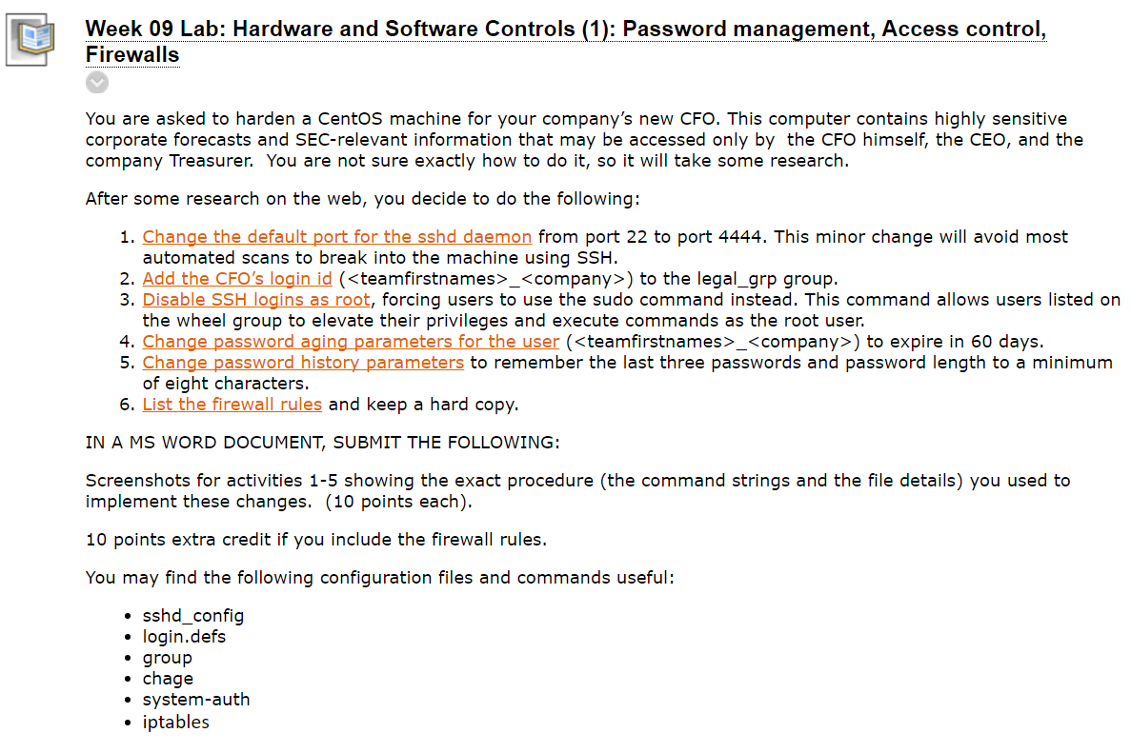
Homework Lab_9

Slide 44
Discussion 9
POST (due WED 11:59 pm CST): Open your firewalls file and write a firewall rule that blocks all incoming web requests (port 80) from the 192.168.0.0/16 network. Explain how you would test the rule, then conduct the test you have explained and include a screenshot of your rule and your test results.
RESPONSES (due FRI 11:59 pm CST): Respond to two of your peers' posts—copy their rules into your firewalls file and test them based on their explanation. Are you getting the same result your peers are getting? After testing, research how to modify this rule ON THE FLY (i.e. from the command line, not by editing the firewalls file) and add a firewall rule that blocks all incoming web requests (port 80) from the 192.168.0.0/24 network. Why would you want BOTH networks in your firewalls file? (You will need to explain the difference between /16 and /24).

Slide 45
Summary
Define Password Management
Describe and build Access control lists (ACLs)
Analyze Firewalls and their capabilities
Use Intrusion Detection/Prevention Systems
Strategize how to patch operating systems and applications
Deploy End Point Protection
Discuss and apply Information security control best practices

Slide 46
For Next Week
# | Topic | Reading | Due 11:59 pm CST on Blackboard
10 | Hardware and Software Controls (2): Intrusion detection/prevention systems, Patch management for operating systems and applications, End point protection | Agrawal 9 Other materials on Blackboard | W: Post F: Responses S: LAB_10

